Slide 1
File Handling In Python
By Bhimashankar Takalki

Slide 2
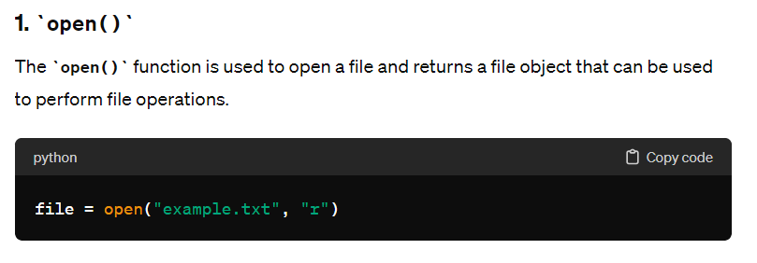
In Python, there are various built-in functions and methods for working with files. These functions and methods allow you to perform different operations on files, such as opening, reading, writing, and closing files. Here are some of the commonly used file functions and methods in Python:

Slide 3
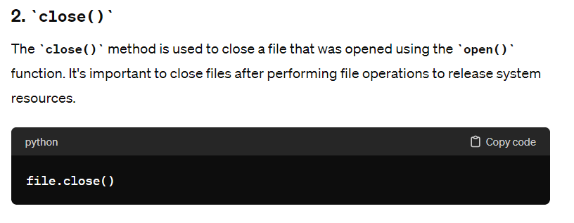
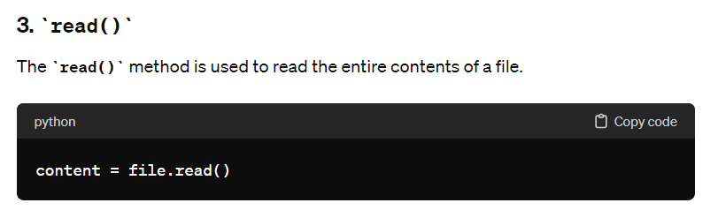

Slide 4
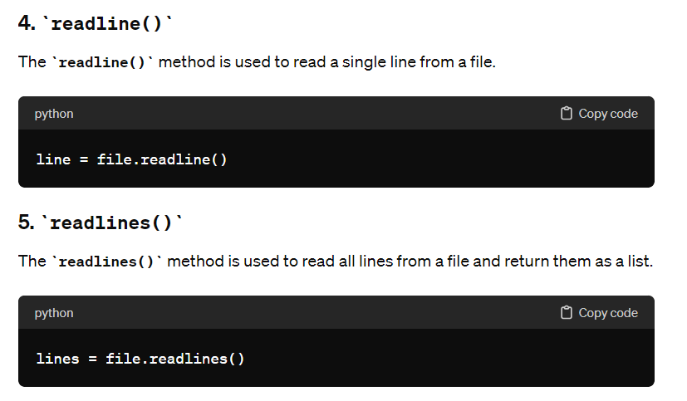

Slide 5
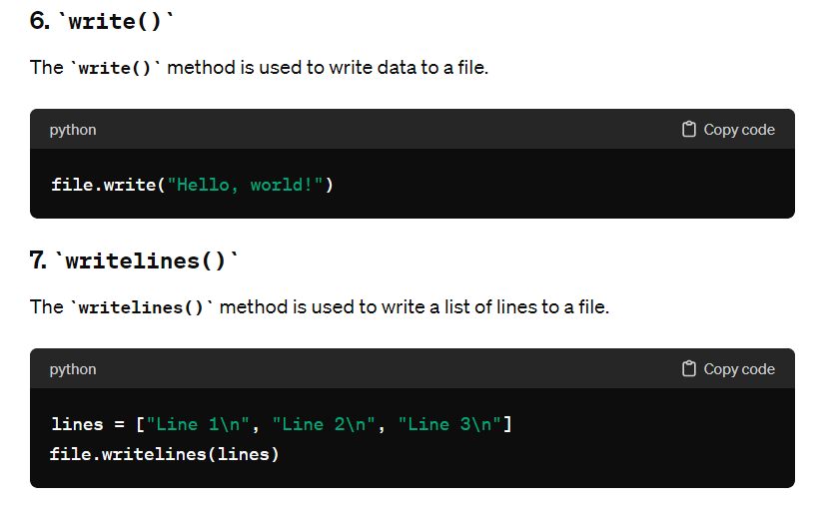

Slide 6
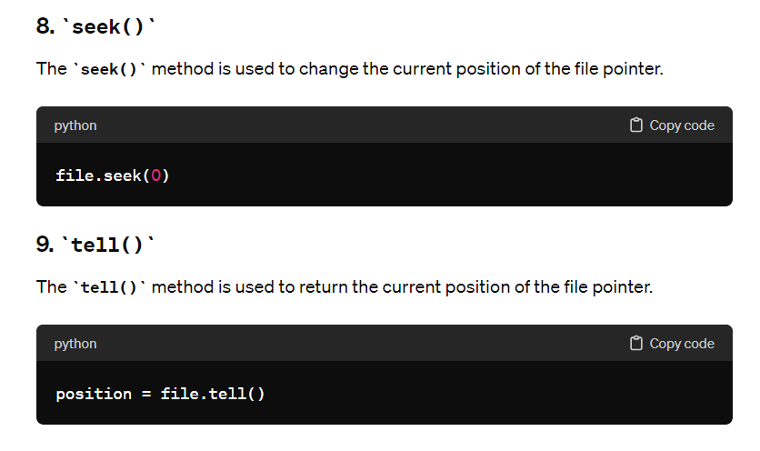

Slide 7
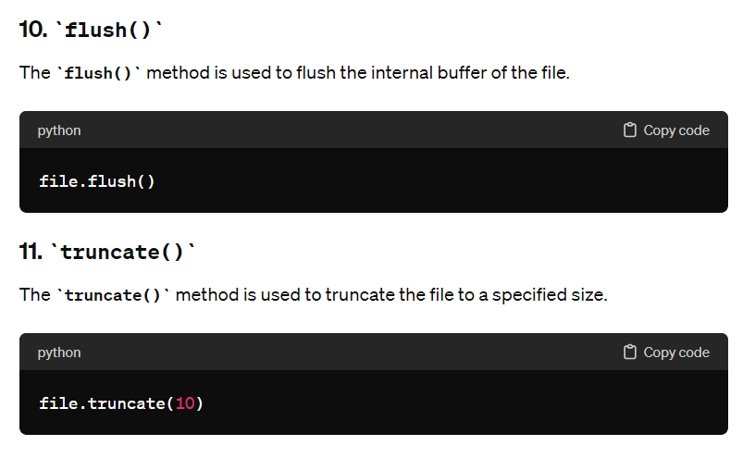

Slide 8
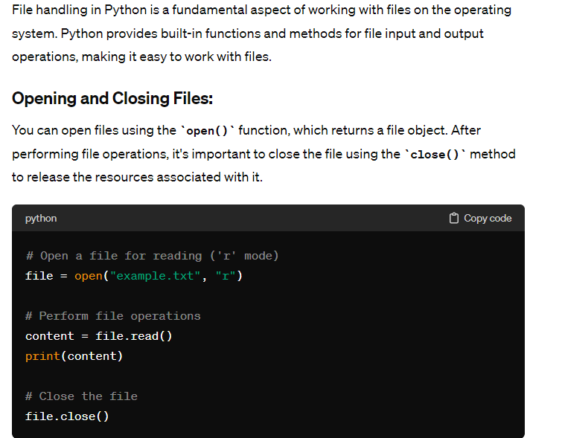

Slide 9
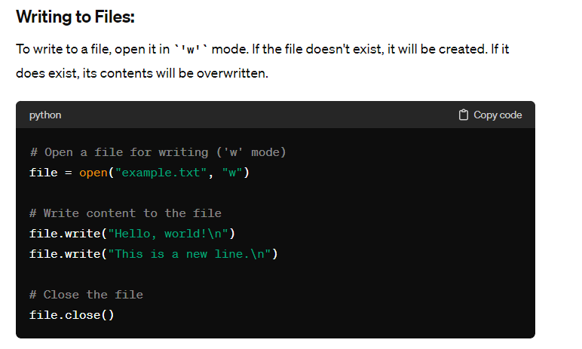

Slide 10
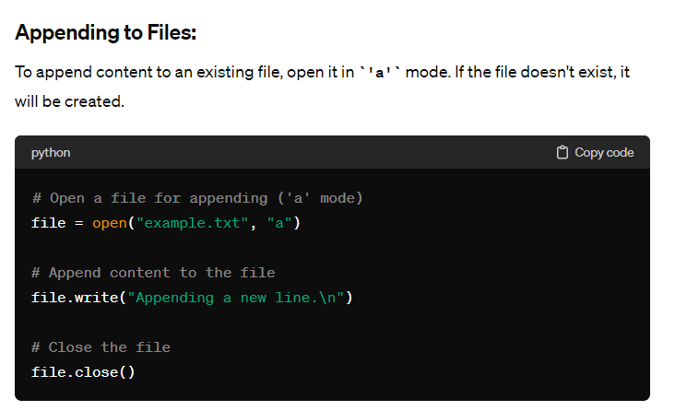

Slide 11
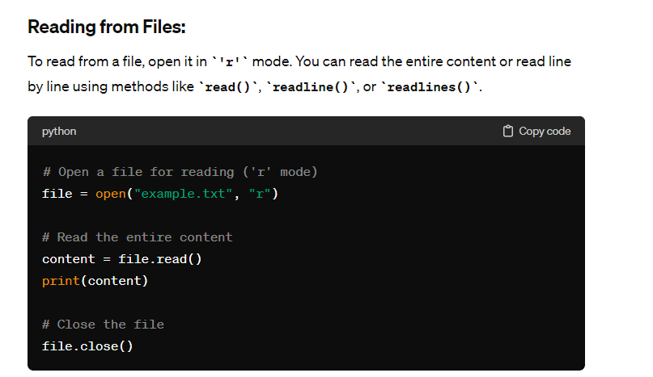

Slide 12
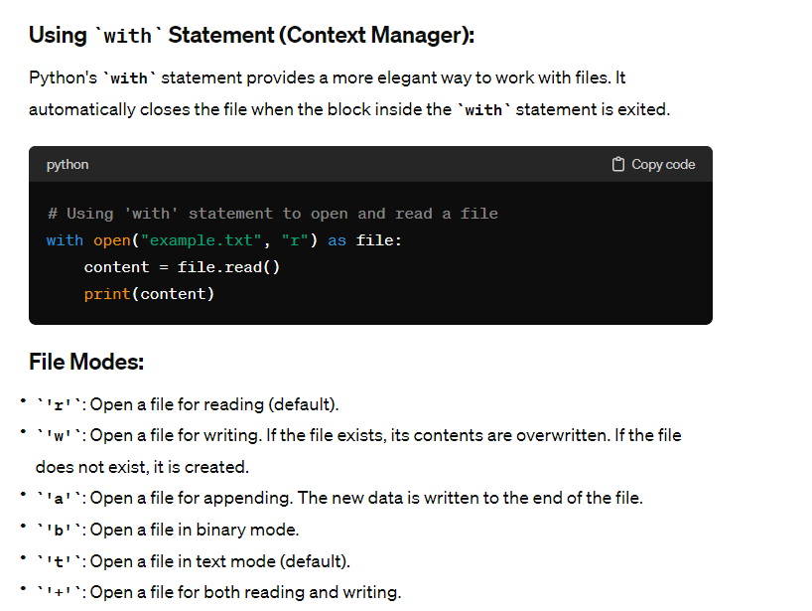

Slide 13
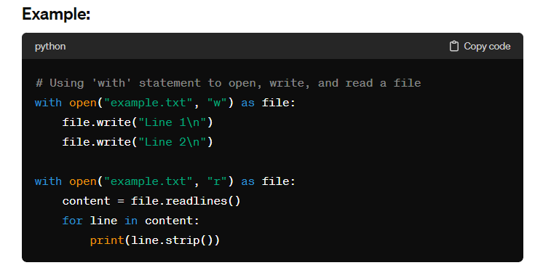

Slide 14
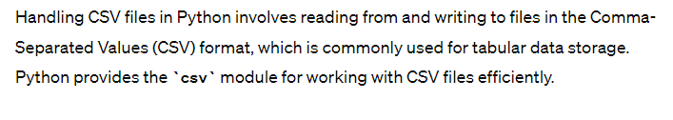

Slide 15
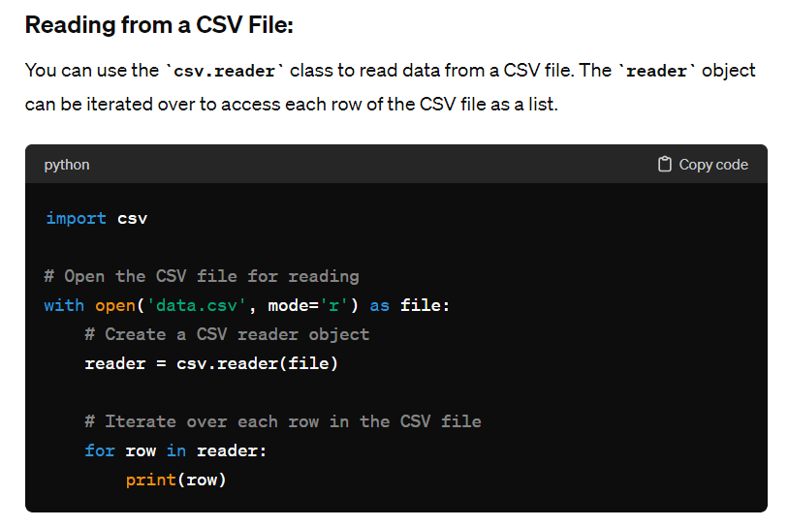

Slide 16
Writing to a CSV File:
To write data to a CSV file, you can use the csv.writer class. You need to provide an iterable (such as a list or tuple) containing the data for each row.
import csv
# Data to be written to the CSV file
data = [
['Name', 'Age', 'City'],
['John', 30, 'New York'],
['Alice', 25, 'Los Angeles'],
['Bob', 35, 'Chicago']
]
# Open the CSV file for writing
with open('output.csv', mode='w', newline='') as file:
# Create a CSV writer object
writer = csv.writer(file)
# Write data to the CSV file
writer.writerows(data)

Slide 17
Using DictReader and DictWriter:
The csv.DictReader and csv.DictWriter classes can be used to read and write CSV files with dictionaries, respectively. This allows you to access data using column names instead of indices.
import csv
# Open the CSV file for reading
with open('data.csv', mode='r') as file:
# Create a DictReader object
reader = csv.DictReader(file)
# Iterate over each row in the CSV file
for row in reader:
print(row['Name'], row['Age'], row['City'])
# Data to be written to the CSV file
data = [
{'Name': 'John', 'Age': 30, 'City': 'New York'},
{'Name': 'Alice', 'Age': 25, 'City': 'Los Angeles'},
{'Name': 'Bob', 'Age': 35, 'City': 'Chicago'}
]
# Open the CSV file for writing
with open('output.csv', mode='w', newline='') as file:
# Define column names for the CSV file
fieldnames = ['Name', 'Age', 'City']
# Create a DictWriter object
writer = csv.DictWriter(file, fieldnames=fieldnames)
# Write column headers to the CSV file
writer.writeheader()
# Write data to the CSV file
writer.writerows(data)

Slide 18
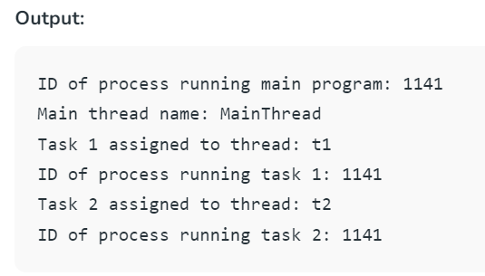

Slide 19
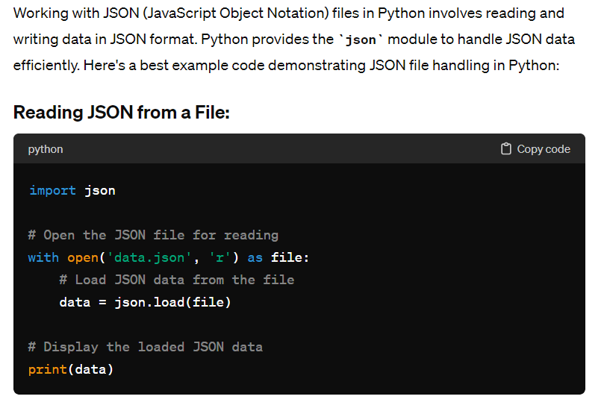

Slide 20
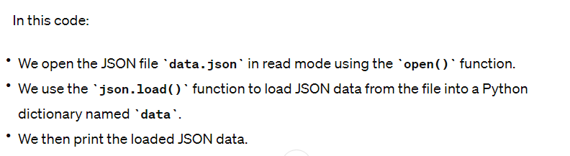

Slide 21
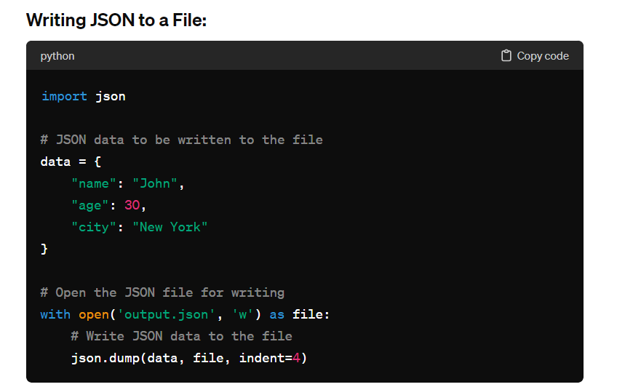

Slide 22
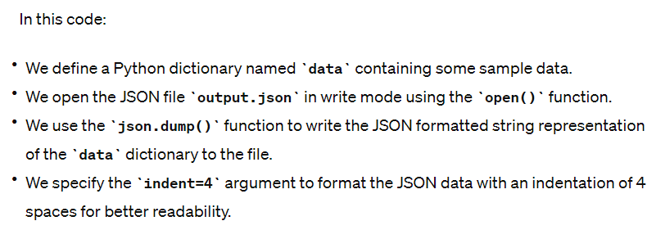

Slide 23
Example: Reading and Writing JSON Data
import json
# JSON data to be written to the file
data = {
"name": "John",
"age": 30,
"city": "New York"
}
# Writing JSON data to a file
with open('data.json', 'w') as file:
json.dump(data, file, indent=4)
# Reading JSON data from the file
with open('data.json', 'r') as file:
loaded_data = json.load(file)
# Display the loaded JSON data
print(loaded_data)

Slide 24
